Slide 1
Streams:
The second outlet for derived data generated in Hadoop is as a stream back into Kafka
useful for applications that need a change log of the underlying data
implemented as a HadoopOutputFormat
data is published as a change-log of data tuples
script to push a stream of session-based page-views
sessions = FOREACH pageviews GENERATE Sessionize(*);STORE sessions INTO ’kafka://kafka-url’ USINGStreams(’topic=SessionizedPageViewEvent’)

Slide 2
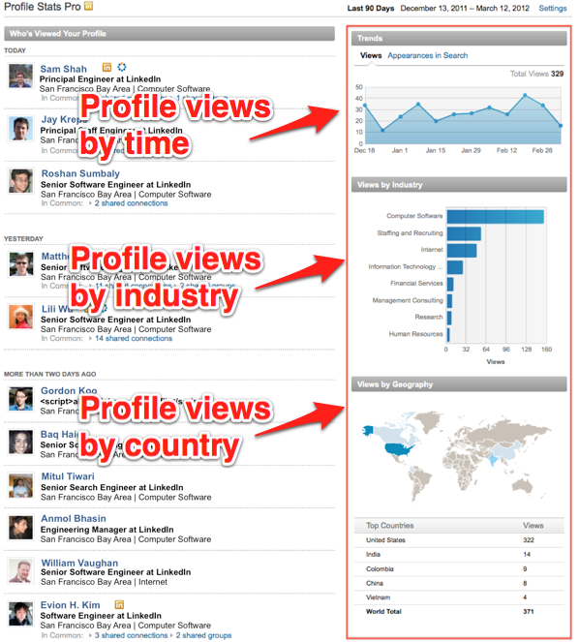
OLAP: data is transformed offline into multi-dimensional cubes for later online analytical queries..
LinkedIn has many analytical insight products such as "Who's Viewed My Profile?“ and "Who's Viewed This Job?".
these are multidimensional queries. For example, "Who's Viewed My Profile?" takes someone's profile views and breaks them down by industry, geography, company, school, etc to show the people who viewed their profiles
Problem: A system that can answer these queries in milliseconds across 175+ million members.
Reference:https://engineering.linkedin.com/olap/avatara-olap-web-scale-analytics-products

Slide 3
Avatara:
Avatara is LinkedIn's scalable, low latency, and highly-available OLAP system for "sharded" multi-dimensional queries in the time constraints of a request/response loop. It has been successfully powering "Who's Viewed My Profile?" and other analytical products
Avatara consists of two components:
An offline engine that computes cubes in batch
An online engine that serves queries in real time
Notes:
he offline engine computes cubes with high throughput by leveraging Hadoop for batch processing. It then writes cubes to Voldemort, LinkedIn's open-source key-value store. The online engine queries the Voldemort store when a member loads a page

Slide 4
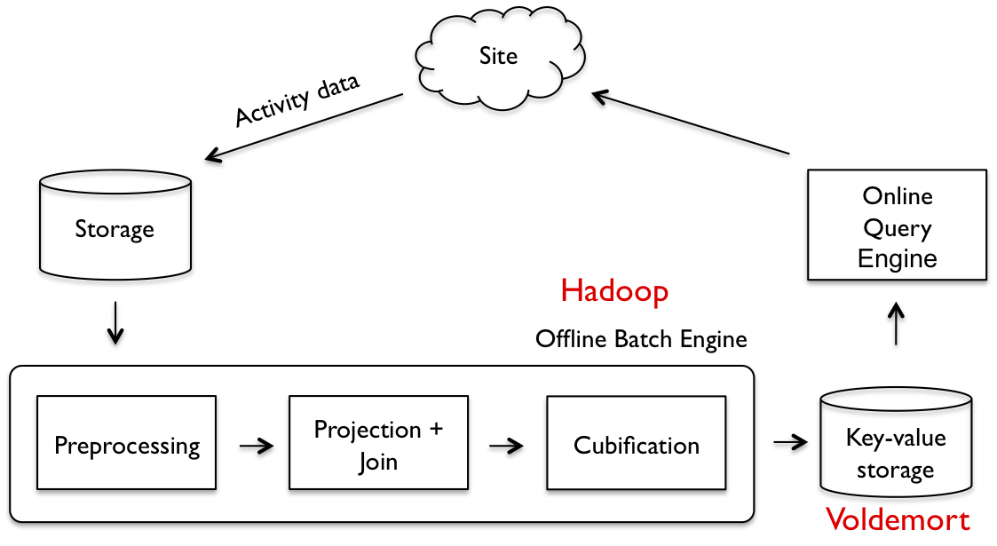
The pipeline preprocess raw data as needed
Projects out dimensions of interest,
Performs user-defined joins,
Transforms the data to cubes
The result of the batch engine is a set of sharded small cubes, represented by key-value pairs, where each key is a shard (for example, by member_id for "Who's Viewed My Profile?"), and the value is the cube for the shard.
The online query engine retrieves and processes data from Voldemort, returning results back to the client.
It provides SQL-like operators, such as select, where, group by, plus some math operations.
Reference:https://www.linkedin.com/pulse/reinventing-people-you-may-know-linkedin-mitul-tiwari/

Slide 5
APPLICATIONS
Most features at LinkedIn rely on this data pipeline either explicitly(data being the product), or implicitly (derived data infusing into the application).
Many applications leverage the Kafka ingress flow and use Azkaban as their workflow and dependency manager to schedule their computation at some schedule
Key-value
Key-value access using Voldemort is the most common egress mechanism from Hadoop.
Over 40 different products use this mechanism and it accounts for approximately 70% of all Hadoop data deployments at LinkedIn

Slide 6
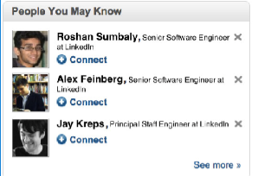
People You May Know (PYMK): recommends other people to connect with allowing members to grow their. The two main challenges in building are: Machine learning Scale
In terms of machine learning,
the basic problem behind PYMK is link prediction over social graph, that is, figuring out missing edges on the social graph that are present in the real life, but may not yet reflected on LinkedIn’s professional graph.
There are many feature or signals used for predicting whether two people know each other. One of the first thing to look is friends-of-friends or triangle closing, overlapping organizations

Slide 7
In terms of scale,
PYMK system daily processes 100s of terabytes of data, 100s of billions of potential connections, and pushes new PYMK results every day.
As PYMK look at second degree network (connections of connections), the rate of growth in the data processing is much faster than the site growth.
keep optimizing PYMK system to deal with such high growth in data processing while keep refreshing PYMK results every day
Solution:
LinkedIn has built an ecosystem of big data for addressing scaling challenges in PYMK including many systems such as Voldemort key-value store, Azkaban Hadoop workflow management, Apache Kafka for streaming, for simplifying data processing in Hadoop PIG, Cubert for efficient joins and data processing, etc.

Slide 8
Azkaban helps manage the size and complexity of this workﬂow by dividing into sub workflows
managed by Azkaban and alerts are sent to LinkedIn’s operations
conducts numerous split or A/B tests
test the workﬂow on thedevelopment Hadoop grid,publish the new workﬂow into the executing system
push a key-value store where the key is a member identiﬁer and the value is a list of member id, score pairs
Kafka retrieves by a simple get, applies business rules
Azkaban Hadoop workflow management,
Voldemort key-value store
Apache Kafka for streaming,

Slide 9

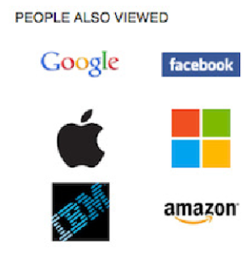
Collaborative Filtering: Co-occurrence or
association rule mining
LinkedIn’s frontend framework emits activity events on
every page visit as part of LinkedIn’s base member activity
tracking.
uses these events to construct a co-occurrence
matrix with some entity speciﬁc tuning
This matrix is partially updated periodically
depending on the needs
The resulting key-valuestore is a mapping from an
entity pair—the type of the entity and its
identiﬁer — to a list of the top related entity pairs

Slide 10
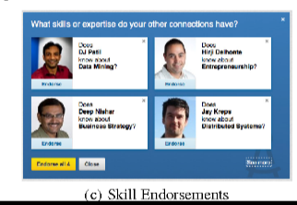
Skill Endorsements: where a member can afﬁrm another member in their network for a skill
A workﬂow ﬁrst determines skills that exist across the memberbase
which is a deep information extraction problem
synonym detection
disambiguation
another joins proﬁle, social graph, group, and other activity data to determine the canonicalized skills for a member
These are pushed as a key-value store wrapped by a service that exposes an API for any client to determine a member’s skills and resolve skill identiﬁers
resulting recommendations are delivered as a key-value store mapping a member id to a list of member, skill id, and score triples

Slide 11
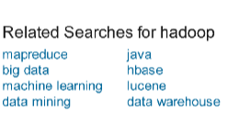
.Related Searches :
provide an important navigational aid for improving members’ search experience in ﬁnding relevant results to their queries.
The search backend emits search activity events and the resulting store is keyed by search term

Slide 12
Thank you!

